Slide 1
ECE 260C, Spring 2025 Floorplan and PDN
Andrew B. Kahng
Thanks to: Zhiang Wang, Peter Gadfort
Kahng ECE 260C SP25

Slide 2
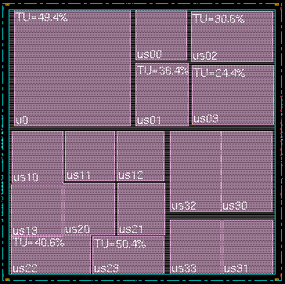
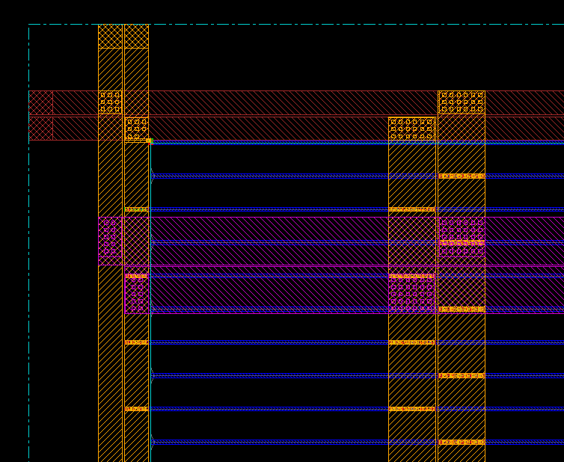
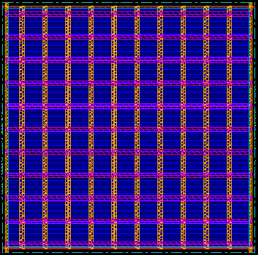
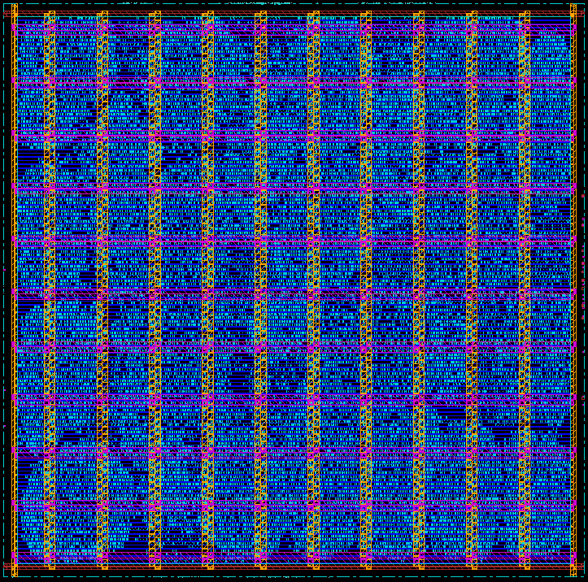
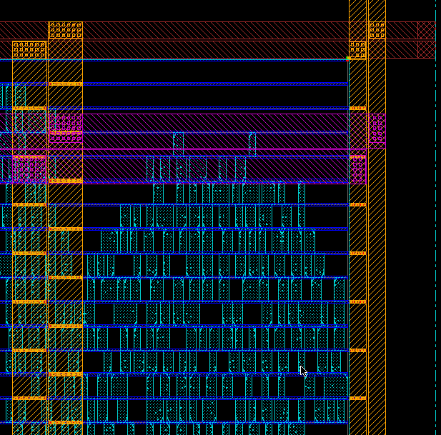
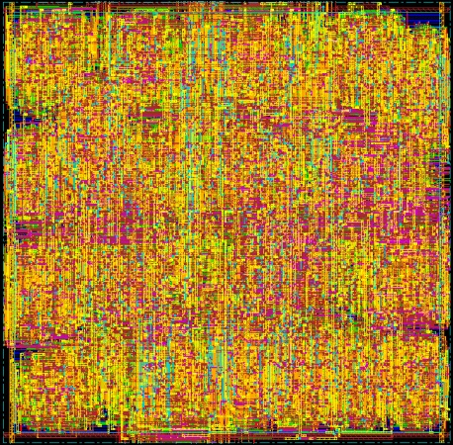
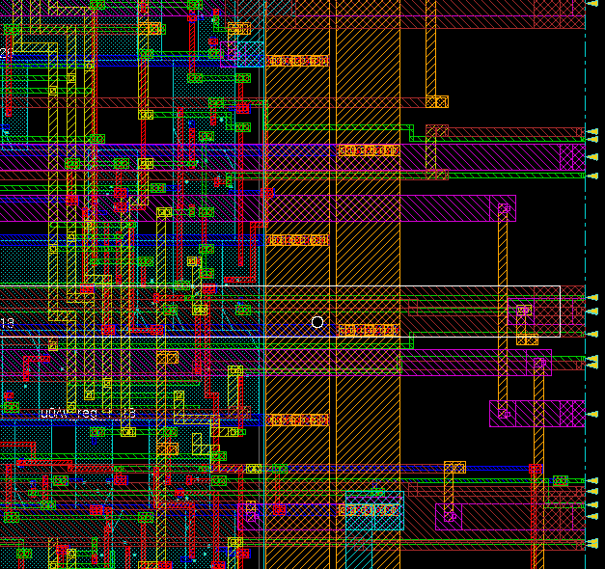
Physical Design Flow Pictures (old ECE 260B slide)
Floorplanning
Powerplanning
Placement
Routing

Slide 3
Floorplanning
Kahng ECE 260C SP25

Slide 4
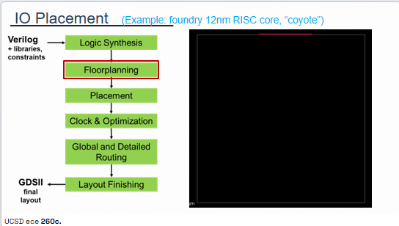
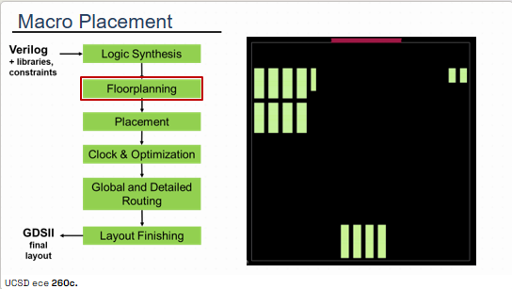
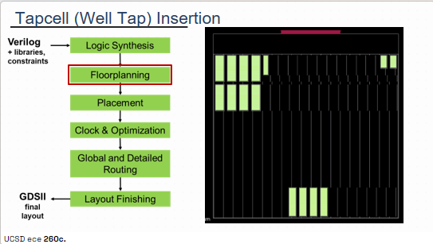
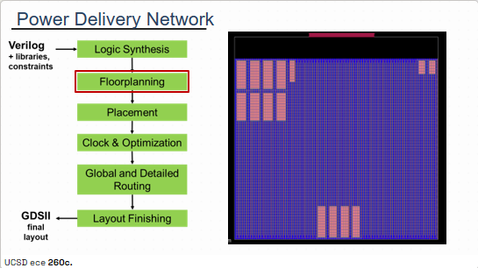
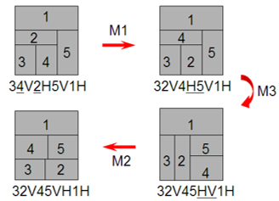
Recall: “Floorplanning” Performs Many Tasks !
https://openroad.readthedocs.io/en/latest/main/src/ifp/README.html ++
IO placement = ppl
Macro placement = mpl
Objectives? Constraints?
Representation? (Realization?) Optimization?
Tapcell insertion = tap
PDN generation = pdn
Notes:
Normalized Polish Expression (NPE): no consecutive H’s or V’s
Chain: HVHVH.... or VHVHV....
M1: Swap adjacent operands (ignoring chains)
M2: Complement (= reverse) some chain
M3: Swap an adjacent operand and operator (can give an invalid NPE, so must check validity of this move)

Slide 5
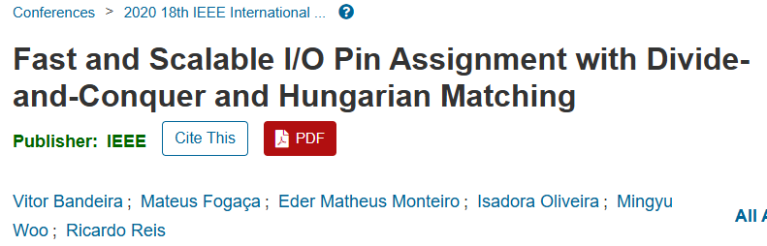
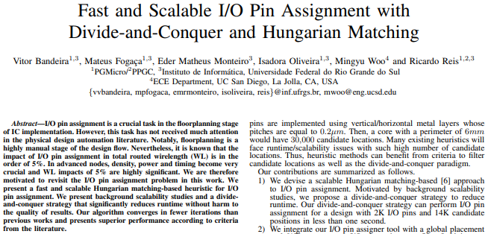
Pin Placement (ppo)
https://ieeexplore.ieee.org/document/9159791
Kahng ECE 260C SP25
Notes:
Global router and PPO and first CTS implementation …

Slide 6
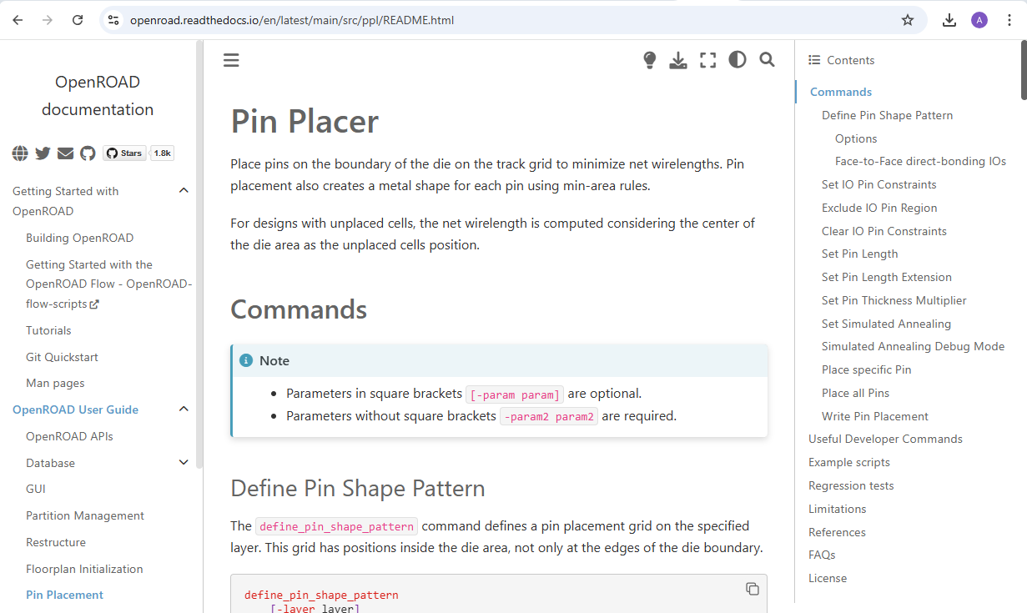
ppo = pin placement optimizer
Where should pins be placed?
Chicken-egg: core determines periphery, and vice-versa!
Basic approach: “iterate until convergence …”
Sometimes, designer wants to provide guidance/constraints
Sometimes, the guidance/constraints are wrong (!) e.g., infeasible

Slide 7
Macro Placement: Hier-RTLMP (mpl)
Thanks to Dr. Zhiang Wang zhw033@ucsd.edu
Kahng ECE 260C SP25

Slide 8
Motivation
Macro placement is a critical component of the “handoff” from frontend to the backend of a physical synthesis flow.
Human experts usually need to consider multiple factors when they do macro placement:
Dataflow
Logical hierarchy
Connectivity between macros and input-output (IO) pins
…
ML hardware accelerators make the macro placement become more challengeable:
Hundreds of macros (examples will be given in the next slide)
Complex RTL structure with long, inscrutable autogenerated module names
Kahng ECE 260C SP25

Slide 9
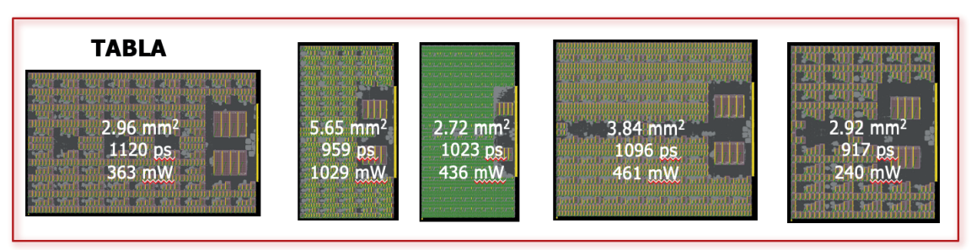
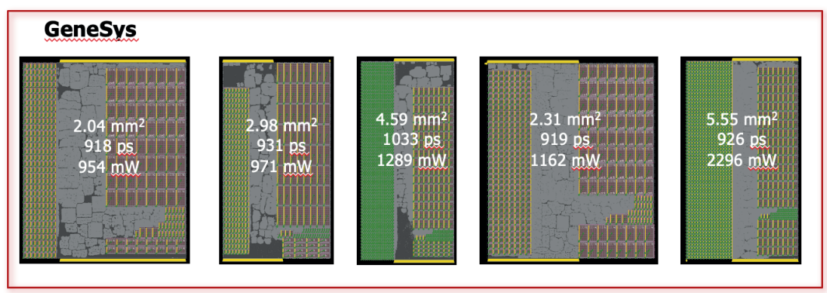
Macro-Dominated ML Accelerators (paper: c397)
TABLA: machine learning accelerators for non-DNN algorithms
GeneSys: machine learning accelerators for DNN algorithms
Kahng ECE 260C SP25

Slide 10
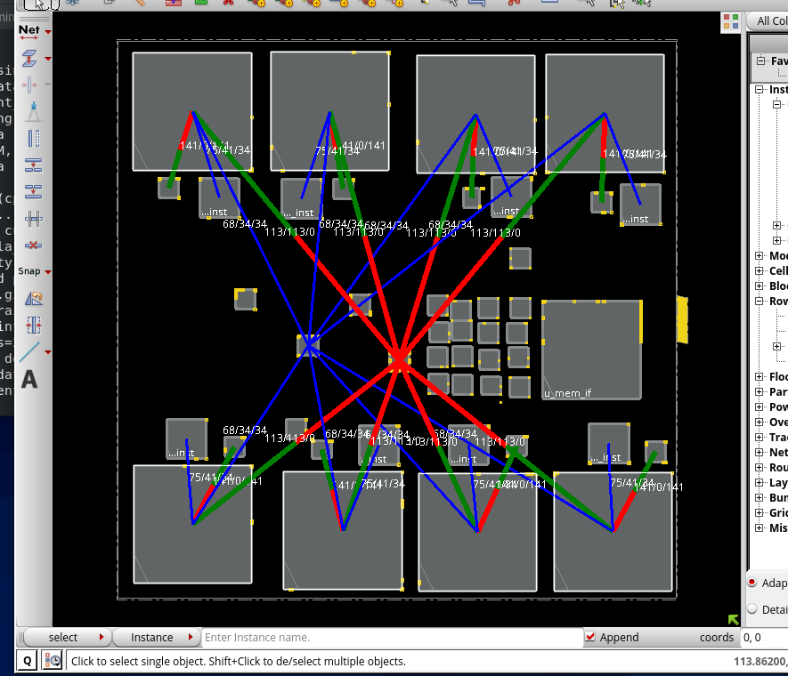
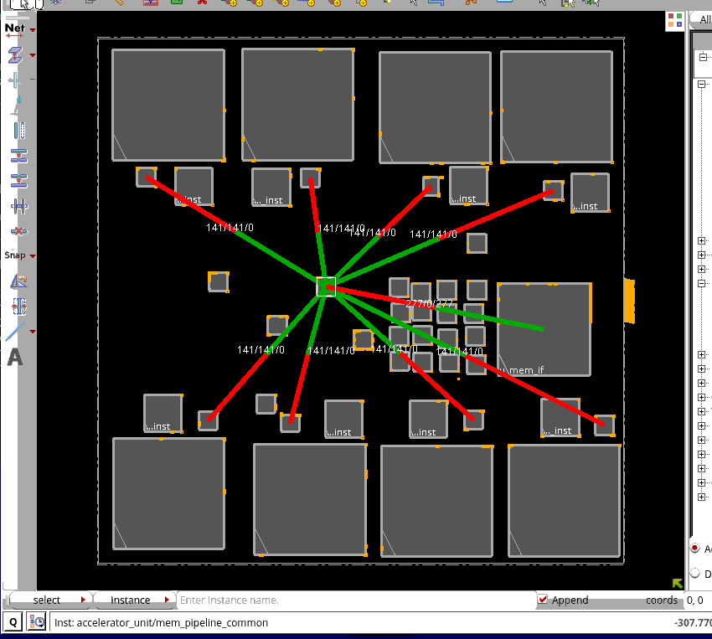
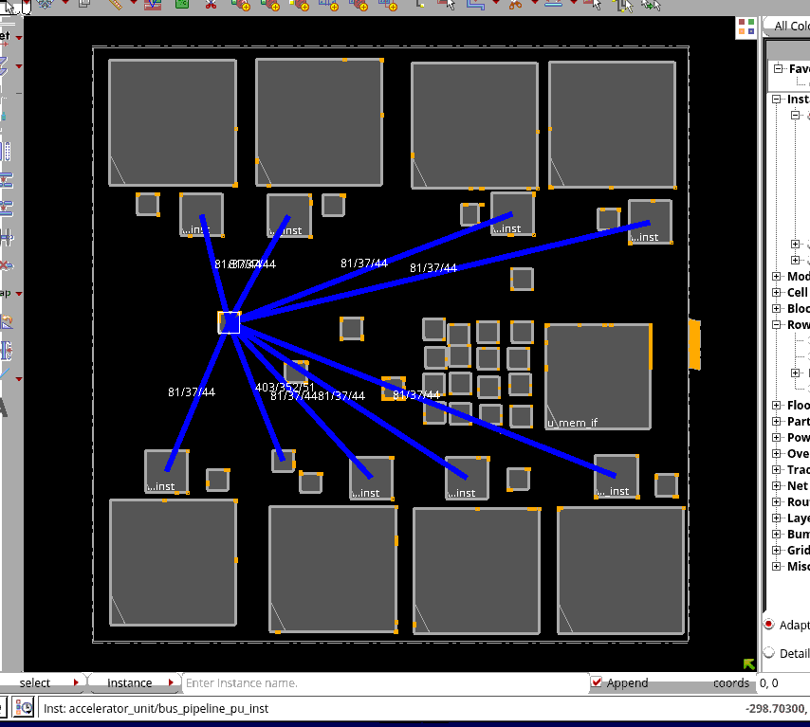
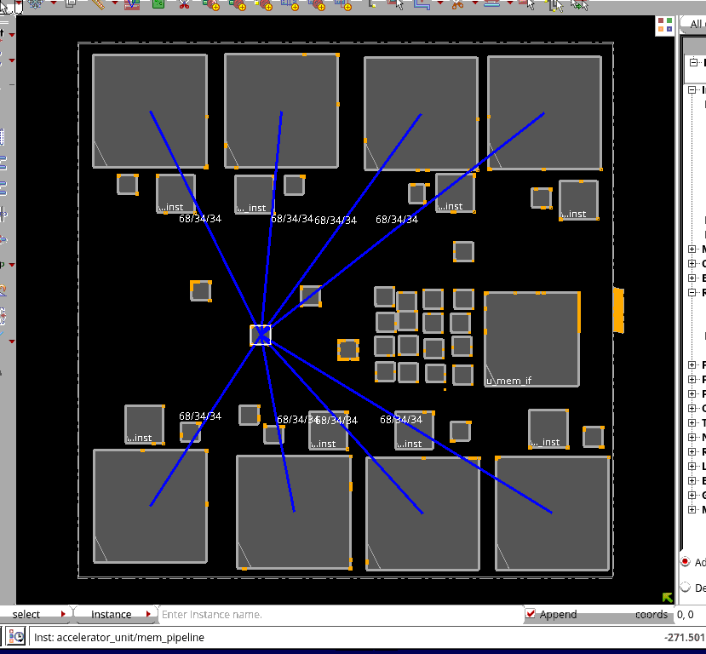
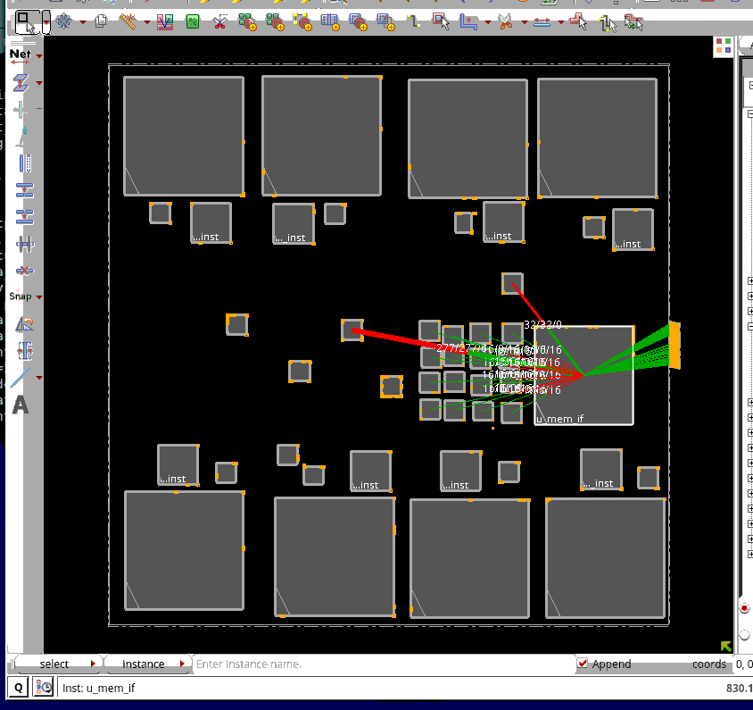
Dataflow Analysis by Humans
Dataflow refers to the movement of data between different functional units.
TABLA: systolic array structures
(Processing Units + Ctrl Logic + Mem Blocks)
Kahng ECE 260C SP25

Slide 11
What Should a Human-quality Macro Placer Do ?
Conceptual abstractions devised by the frontend designer
Functional interactions and dataflow between logical modules
Macro placement guidance with preferred locations for macros
Common constraints such as macro placement blockages
1
2
“human-quality”
macro placers
should
understand
3
4
Kahng ECE 260C SP25

Slide 12
Macro Placer in OpenROAD: Hier-RTLMP
Conceptual abstractions devised by the frontend designer
Through converting the structural netlist representation of the RTL design into a clustered netlist
Hier-RTLMP
cluster
bundled
connections
Kahng ECE 260C SP25

Slide 13
Macro Placer in OpenROAD: Hier-RTLMP
Functional interactions
Through analyzing the dataflow between logical modules (including Input-Output pins)
Hier-RTLMP
Kahng ECE 260C SP25

Slide 14
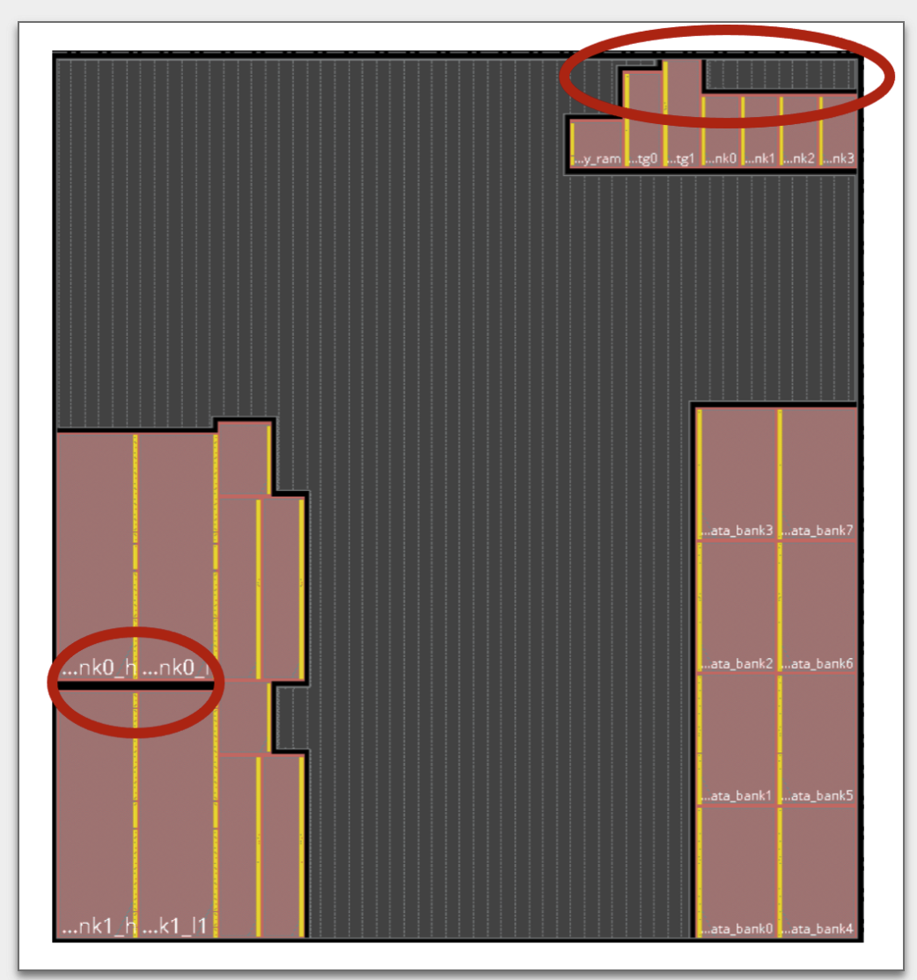
Macro Placer in OpenROAD: Hier-RTLMP
Macro placement guidance
Through pushing macros to their preferred locations
Macro placement blockages
Small dead space (notch) avoidance
Pushing macros to peripheries
Hier-RTLMP
notch
Kahng ECE 260C SP25

Slide 15
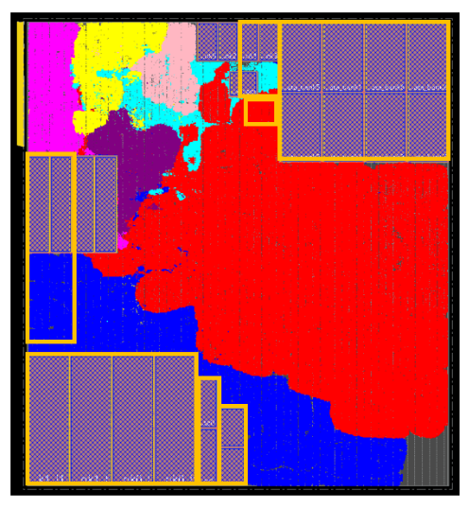
Macro Placer in OpenROAD: Hier-RTLMP
Common constraints
Fixed macro constraints
Through pushing macros to their preferred locations
Hier-RTLMP
macro
guidance
Kahng ECE 260C SP25

Slide 16
Hier-RTLMP flow (paper: link)
.def (floorplan def with placed IO pins)
.v (hierarchical netlist)
.lef + .lib + .sdc
.def (floorplan def with placed IO pins)
.v (hierarchical gate-level netlist)
.lef + .lib + .sdc
Multilevel Autoclustering Engine
Autoclustering Engine
Static Timing
(OpenSTA)
Clustered netlist
Coarse Shaping
Shape Engine
OpenROAD
Hier-RTLMP
Rough shape functions
Macro Placement Engine
Shared Data
Model (OpenDB)
Fine Shaping
Accurate shape functions
Hierarchical Macro Placement
Pin Alignment Engine
.def (floorplan def with placed macros)
.def (floorplan def with placed macros)
Kahng ECE 260C SP25

Slide 17
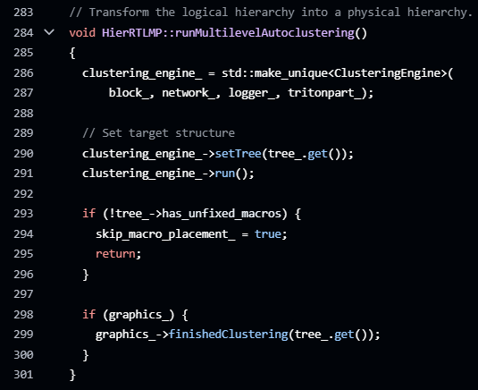
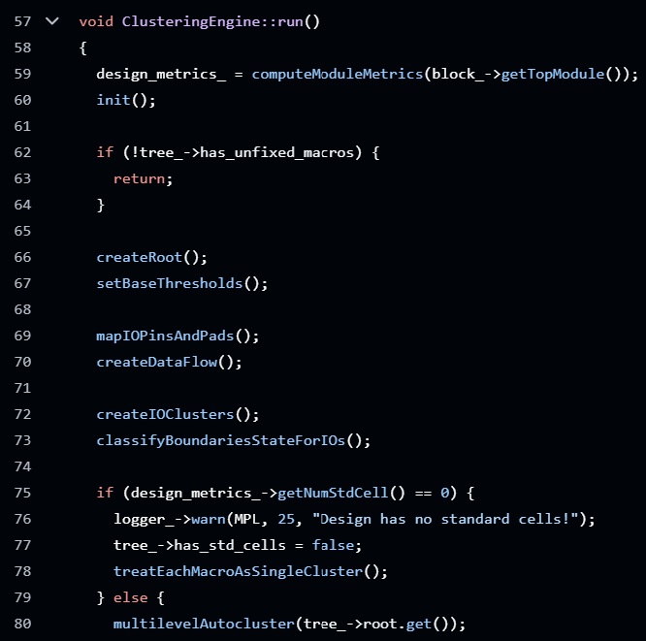
Autoclustering Engine
Converts the structural netlist representation of the RTL design into a clustered netlist (clusterEngine.h)
Logical hierarchy (code)
Connection topology between clusters (code)
Macro regularity = grouping macros based on footprints ((code)
Separation between macros and corresponding standard cell logic (code)
Dataflow between logical modules (including Input-output pins) (code)
Line 284 in hier_rtlmp.cpp (link)
Line 57 in hier_rtlmp.cpp (link)
Kahng ECE 260C SP25

Slide 18

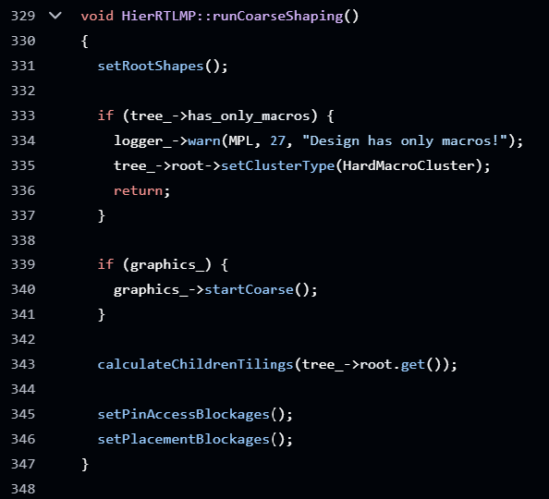
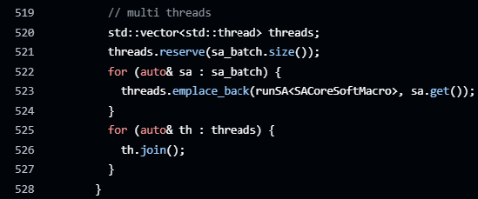
Coarse Shaping
Wait, what? → SA = how we search over solution representations; Sequence Pair = how we represent (macro placement) solutions.
Determine possible rough shapes (area and aspect ratio) for clusters
Simulated Annealing + Sequence Pair
Cost function: minimize the area
Simulated Annealing
Line 469 in hier_rtlmp.cpp (link)
(SACoreSoftMacro.h)
Line 329 in hier_rtlmp.cpp (link)
Multi-threading implementation
Line 519 in hier_rtlmp.cpp (link)
Kahng ECE 260C SP25

Slide 19


Fine Shaping + Hierarchical Macro Placement
Fine Shaping: determine the accurate shape and aspect ratio for each cluster
Pick legal shapes (must fit into the outline of current cluster) for each child clusters
Line 1731 in hier_rtlmp.cpp (link)
Line 1999 in hier_rtlmp.cpp (link)
Kahng ECE 260C SP25

Slide 20
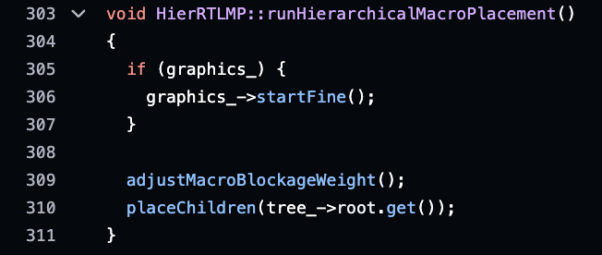
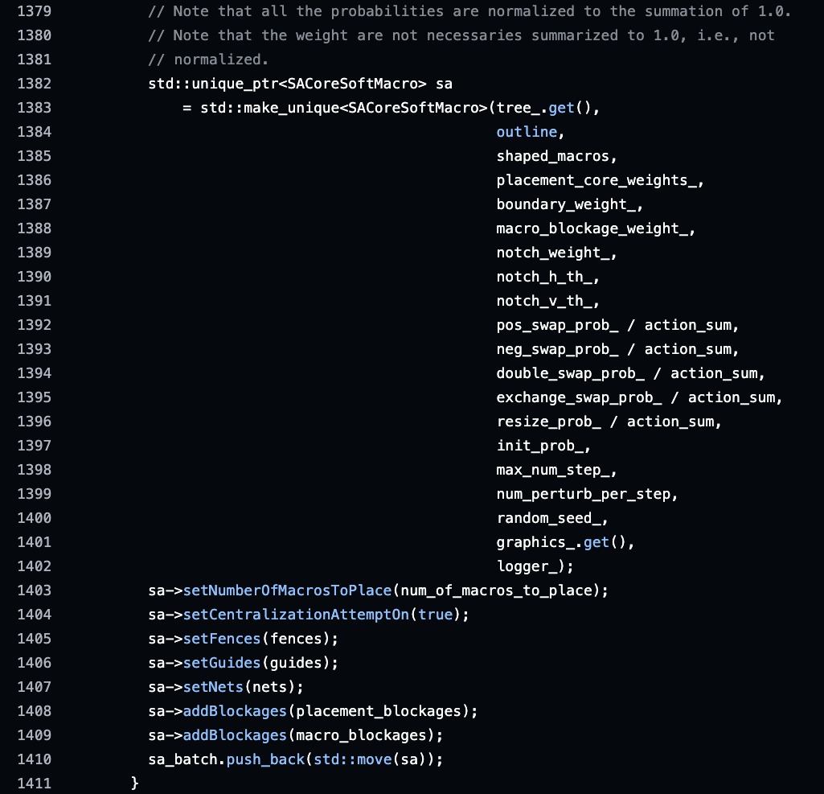
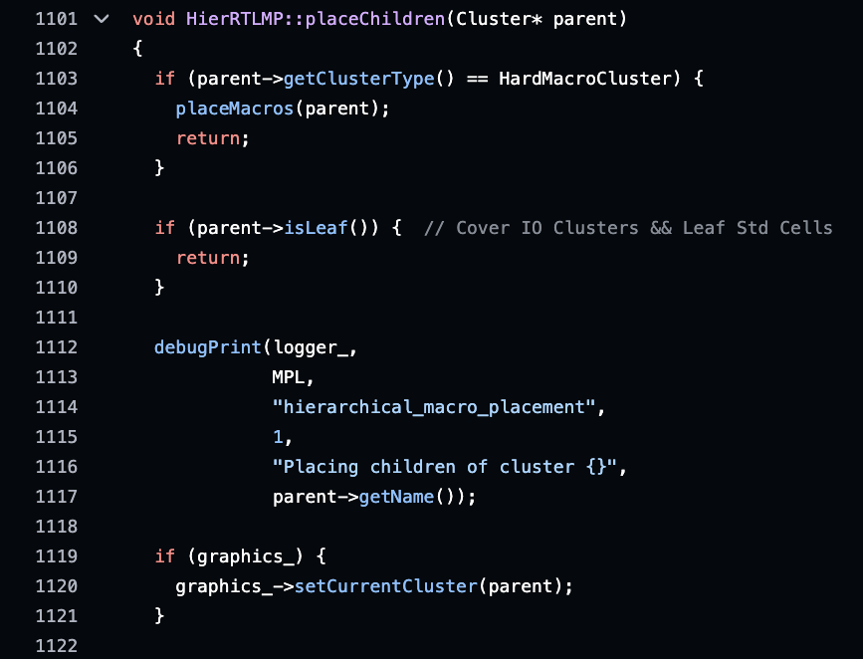
Fine Shaping + Hierarchical Macro Placement
Hierarchical Macro Placement
Clusters are placement level by level in a pre-order DFS manner
Simulated Annealing + Sequence Pair
Cost function: minimize area, wirelength, penalty functions for different constraints (code)
Line 303 in hier_rtlmp.cpp (link)
Line 1379 in hier_rtlmp.cpp (link)
Kahng ECE 260C SP25
Notes:
Message: THIS is what goes on inside an EDA tool (!). And there is more … (under the hood, so to speak)

Slide 21
Sequence Pair and Simulated Annealing Sequence Pair: How we represent the floorplan solution Simulated Annealing: How we (heuristically) optimize the floorplan
Kahng ECE 260C SP25

Slide 22
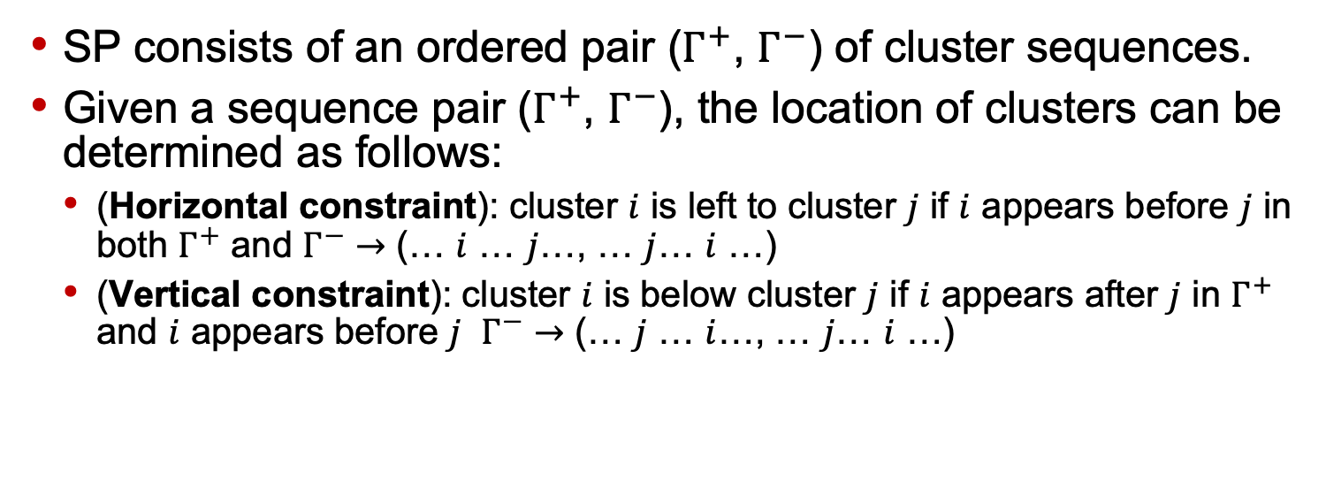
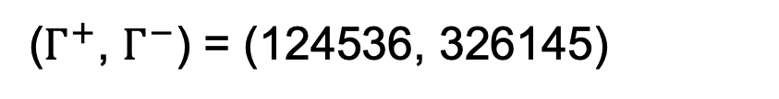
Sequence Pair (SP) (paper: link)
SP consists of an ordered pair ($Γ^{+}$, $Γ^{−}$) of cluster sequences.
Given a sequence pair ($Γ^{+}$, $Γ^{−}$), the location of clusters can be determined as follows:
(Horizontal constraint): cluster $i$ is left to cluster $j$ if $i$ appears before $j$ in both $Γ^{+}$ and $Γ^{−}$ $→$ (… $i$ … $j$…, … $j$… $i$ …)
(Vertical constraint): cluster $i$ is below cluster $j$ if $i$ appears after $j$ in $Γ^{+}$ and $i$ appears before $j$ $Γ^{−}$ $→$ (… $j$ … $i$…, … $j$… $i$ …)
1
4
5
2
Longest Common Subsequence !
(paper: link)
6
3
($Γ^{+}$, $Γ^{−}$) = (124536, 326145)
Kahng ECE 260C SP25

Slide 23
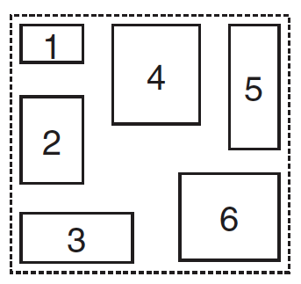
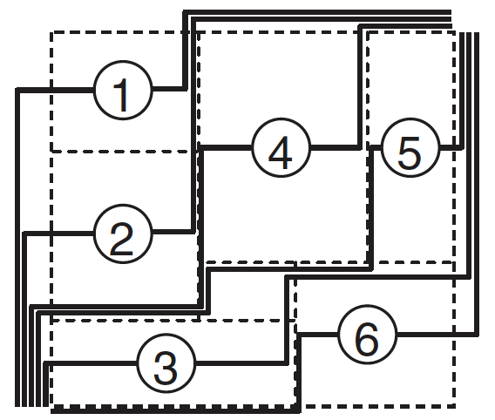
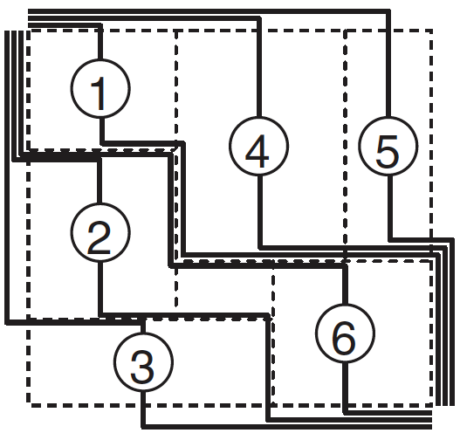
From Floorplan to Sequence Pair
A sequence pair consists of two module name sequences. For example, the floorplan shown at right can be represented as the sequence pair (Γ ₊, Γ₋) = (124536, 326145).
Construction of Γ₊
For each module, draw a right-up locus and a left-down locus as shown in Figure (a). Then we order these loci from the left to right. Γ₊ is resulting order of module names.
Construction of Γ₋
For each module, we draw a up-left locus and a down-right locus as shown in figure (b). Then we order these loci from the left to right. Γ₋ is the resulting order of module names.
Figure (a)
Figure (b)
Think: “non-crossing staircases”

Slide 24
Another example of (up-left, down-right) ordering Γ₋
Γ₋ = CEDFAB (Exercise: What is Γ₊ ?)
C
A
D
E
B
F
Notes:
ABCDEF ?

Slide 25
From Sequence Pair to Floorplan
Given an SP (Γ₊, Γ₋), the geometric relation between modules (clusters) is derived from the SP:
Horizontal constraint: module i is to the left of module j if i appears before j in both Γ₊ and Γ₋ (... i ... j ..., ... i ... j ...)
Vertical constraint: module i is below module j if i appears after j in Γ₊ and i appears before j in Γ₋. (..... j ... i ..., ... i j...)
From horizontal constraints: Create a horizontal constraint graph with a source and a sink, and a node-weighted directed acyclic graph G_{H} (V,E), where V is the set of nodes, and E is the set of edges as follows:
V source s, sink t, and n nodes labeled with module names
E: (s, t) and (i, t) for each module i, and (i, j) if and only if module i is on the left of module j (horizontal constraint).
Node weight : zero for s and t, width of module i for node i.
From vertical constraints: create a vertical constraint graph G_{V} (V,E).

Slide 26
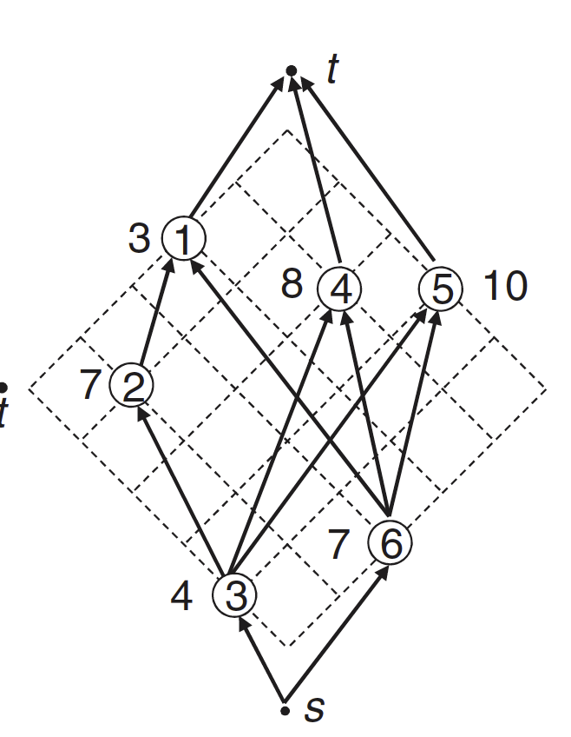
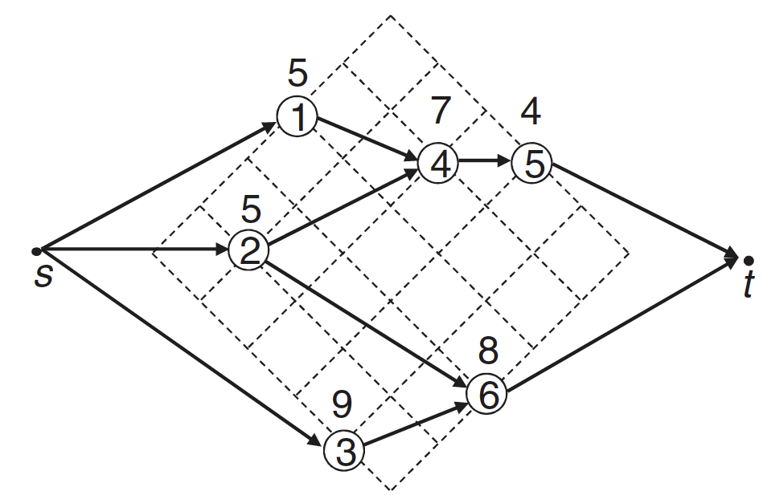
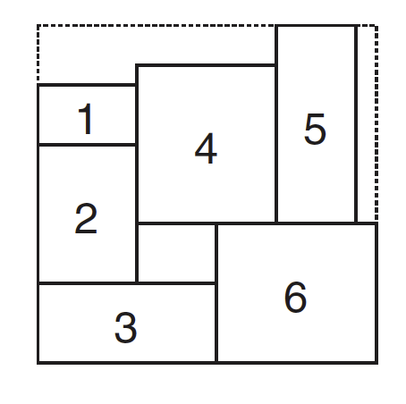
From Sequence Pair to Floorplan
For sequence pair (Γ₊, Γ₋) = (124536, 326145), we construct the HCG (a) and the VCG (b)
A “longest common subsequences” algorithm (see AdyaM03) is used in calculating this final floorplan (c)
Figure (a)
Figure (b)
Figure (c)
Concepts from CSE 21 or CSE 101 – discrete math, algorithms

Slide 27
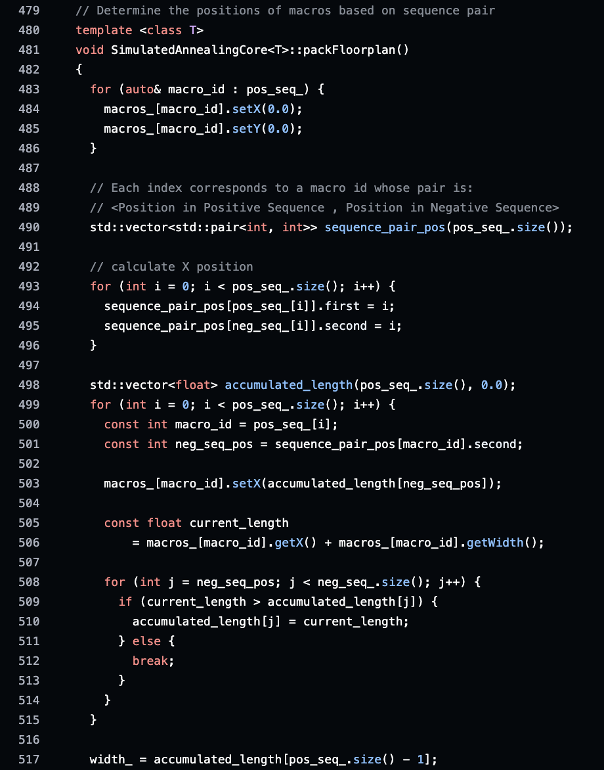
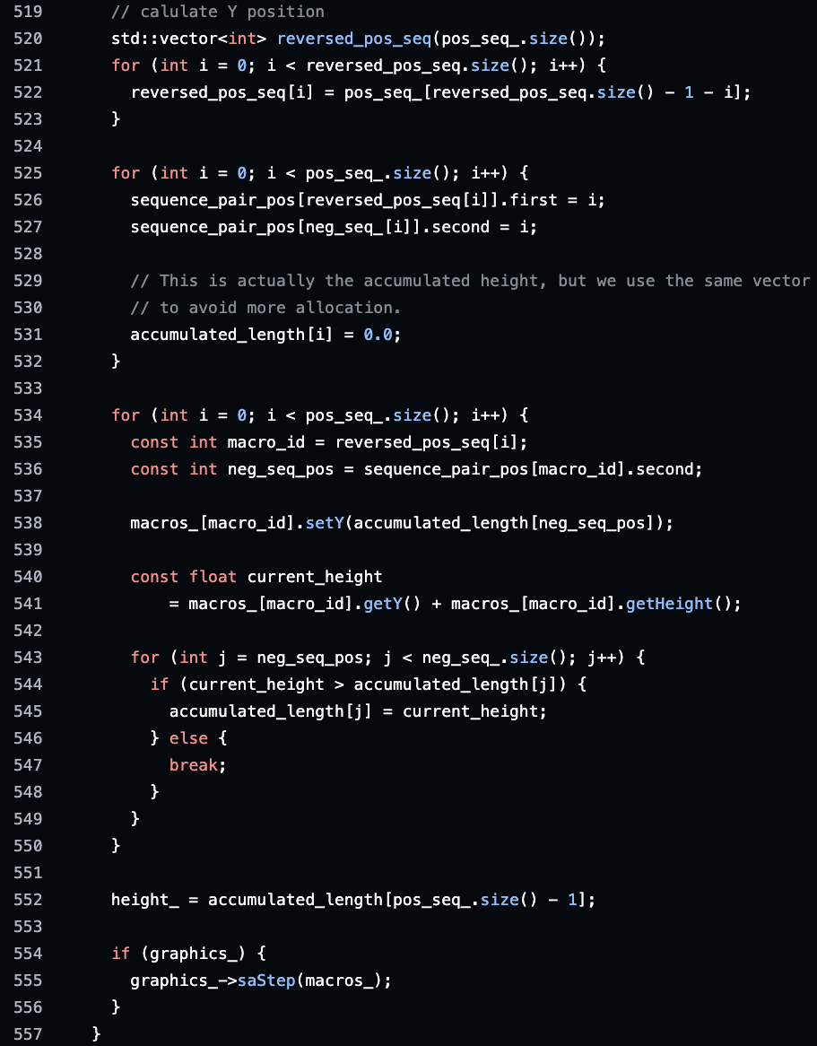
Sequence Pair (SP) (code)
Line 479 in SimulatedAnnealingCore.cpp (link)
Kahng ECE 260C SP25

Slide 28
Constraints in Hierarchical Macro Placement
Fixed outline: All clusters should be placed within the fixed outline specified by users. (code)
Macro peripheral bias: All macros should be pushed to peripheries as much as possible. (code)
Macro blockage: All macros should not overlap with macro placement blockages. (code)
Pin access: All macros should be kept from blocking access of input-output pins. (code)
Macro guidance: All macros should be placed near specified regions if users provide such constraints. (code)
Notch avoidance: A decent floorplan should avoid “dead space” which cannot be used effectively by P&R tools. (code)
Kahng ECE 260C SP25

Slide 29
Simulated Annealing (SA)
Kirkpatrick, Gelatt, Vecchi, Science (1983): One of the most cited scientific papers ever
SA is one of many “metaheuristics” that are used to deal with instances of intractable (NP-hard) combinatorial problems
Genetic algorithms (Holland, U. Michigan)
Tabu search (Glover, U. Colorado)
…
Combinatorial optimization has a physical analogy to the annealing (slow cooling) of metals to produce a perfectly-ordered, minimum-energy state: a “state” is a “solution”, “energy” is “cost”, etc.
Basic idea
Initialize – Start with a random initial solution. Initialize high “temperature”.
Step 2: “Move Gen” – Perturb current solution to obtain a ‘neighbor’ solution
Step 3: Calculate cost change – calculate the change in solution cost due to the move (minimization: negative change is better, positive change is worse)
Step 4: Accept/Reject – Depending on the cost change, accept or reject the move. Probability of acceptance depends on current “temperature”.
Step 5: Update – Update temperature, current solution. Go to Step 2.
Continue until termination condition (‘freezing’ or ‘quenching’) is satisfied
Kahng ECE 260C SP25

Slide 30
Neighborhood Structure
Topology (i.e., “graph”) over the space of solutions
Adjacency in this graph is induced by the definition of “perturbation” (aka “move”)
Traveling Salesperson Problem: switch positions of two cities in the tour
Graph Bisection Problem: swap a pair of vertices between the partitions
TSP: “optimally rearrange the positions of four cities in the tour” → more neighbors, more powerful move, more work to generate a move
Kahng ECE 260C SP25

Slide 31
SA Pseudocode http://www.ecs.umass.edu/ece/labs/vlsicad/ece665/slides/SimulatedAnnealing.ppt
Algorithm SIMULATED-ANNEALING
Begin
temp = INIT-TEMP;
currentSol = INIT-SOLUTION;
for i = 1 to M
candidateSol = NEIGHBOR(currentSol);
ΔC = COST(candidateSol) – COST(currentSol);
if (ΔC < 0) then
currentSol = candidateSol;
else with Pr = e^{-(ΔC/temp)})
currentSol = candidateSol;
temp = SCHEDULE(temp);
End
What happens when temp = +∞ ?
What happens when temp = 0 ?
Kahng ECE 260C SP25

Slide 32
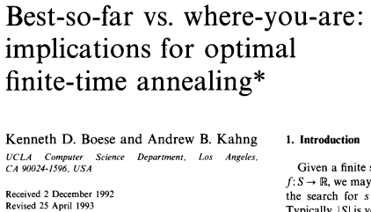
Simulated Annealing Facts
Question: Why is SA so widely applied?
Answer: (1) Easy to implement. (2) Can “handle” almost any discrete optimization (search in a solution space) task. [But: (3) “discrete”, “almost any” are two-edged swords. And (4) SA needs help to scale …]
NEIGHBOR(solution) defines a topology over all solutions in the solution space
At a fixed value of temp, SA behavior corresponds to a homogeneous Markov chain
Matrix of transition probabilities between states
Steady-state (= equilibrium) probability of the Markov chain being in state A is proportional to e^{(-cost(A)/temp)}
When temp → 0, exponentially more likely to be in the global optimum state
“SA is optimal” (in the limit of ‘infinite time’)
Of course, we spend only a finite amount of time (#moves) at any temperature value
Is cooling the best strategy with finite time? See Boese/Kahng, 1993 [link] [link]
Initial state
SA chooses uphill move with
nonzero probability (Hill Climbing)
Greedy Algorithm
gets stuck here!
Locally Optimum
Solution.
SA converges to global opt solution with Pr = 1
(in limit of infinite time, infinitely slow cooling)
Kahng ECE 260C SP25

Slide 33
Neighborhood Structure of Sequence Pair
Solution space
For n modules, the lengths of Γ₊ and Γ ₋ are both n, and thus each of Γ ₊ and Γ ₋ have n! permutations. There are (n!)² permutations for a sequence pair with n modules.
Neighborhood structure
M1 Rotate a module
M2 Swap two modules in only one sequence
M3: Swap two modules in both sequences

Slide 34
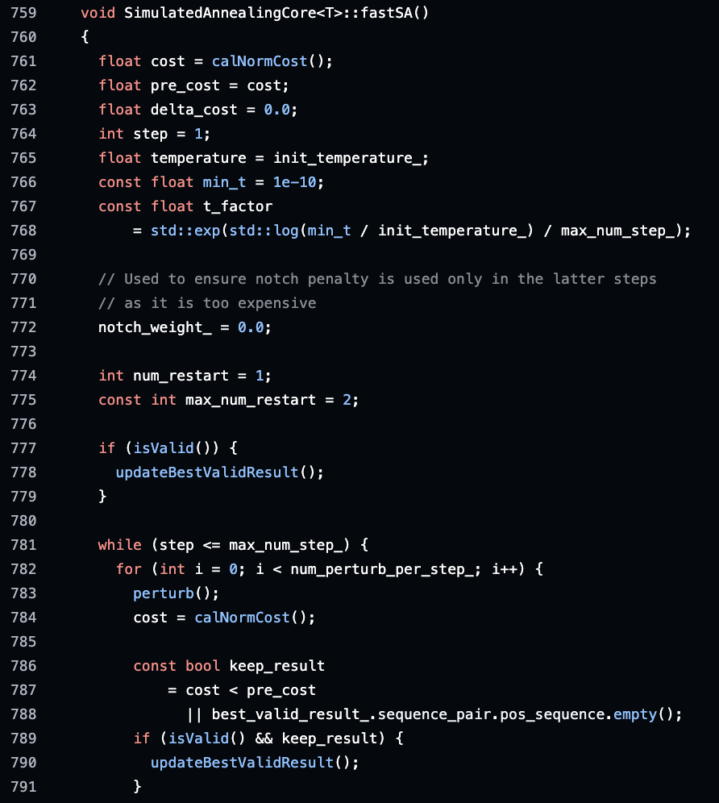
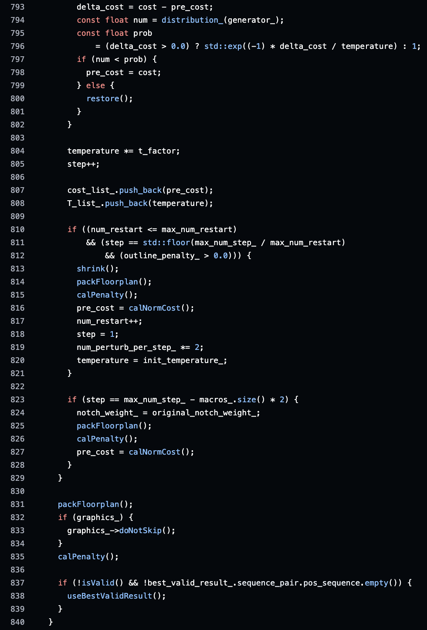
Simulated Annealing (SimulatedAnnealingCore.h)
Accept or Reject ?
Temperature update
Line 759 in SimulatedAnnealingCore.cpp (link)
Kahng ECE 260C SP25

Slide 35
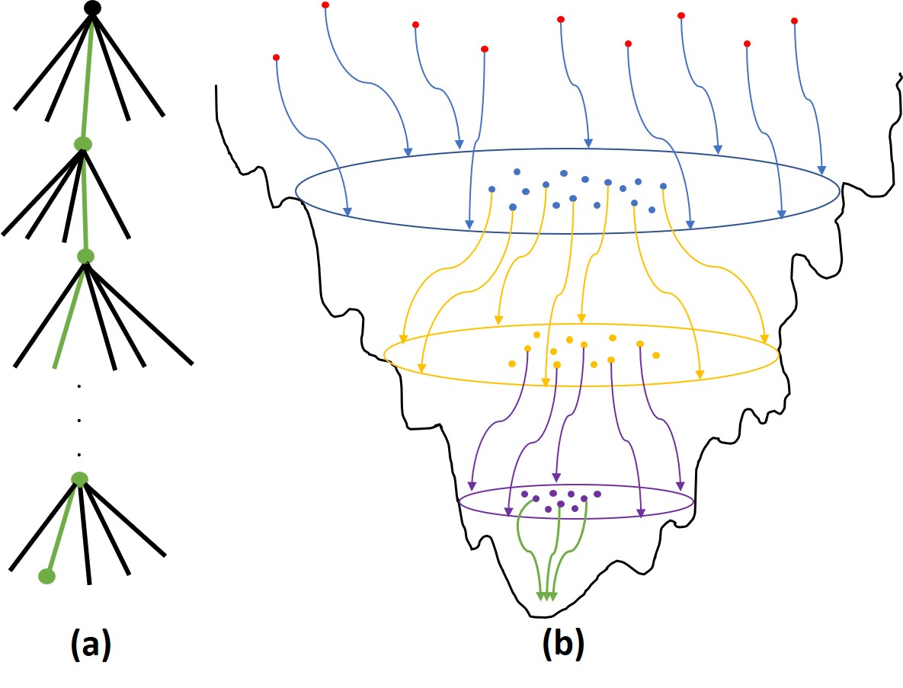
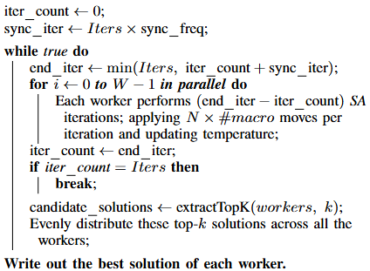
Go-With-The-Winners
D. Aldous and U. Vazirani, “Go With the Winners Algorithms”, Proc. FOCS, 1994, pp. 492-501. [link]
Launch multiple optimization threads
Periodically identify the most promising thread(s)
Clone the promising thread(s) and terminate others
(continue with the optimization) (cf. “evolutionary”, “PPSN”)
Implementation: here
Initialize all SA workers in parallel
Main Loop:
Run each SA worker for sync_iter iterations, in parallel
Stop if Iter iterations have been performed; otherwise, select top k workers and replicate their solutions to remaining workers
Write out best macro placement solution of each worker
Kahng ECE 260C SP25

Slide 36
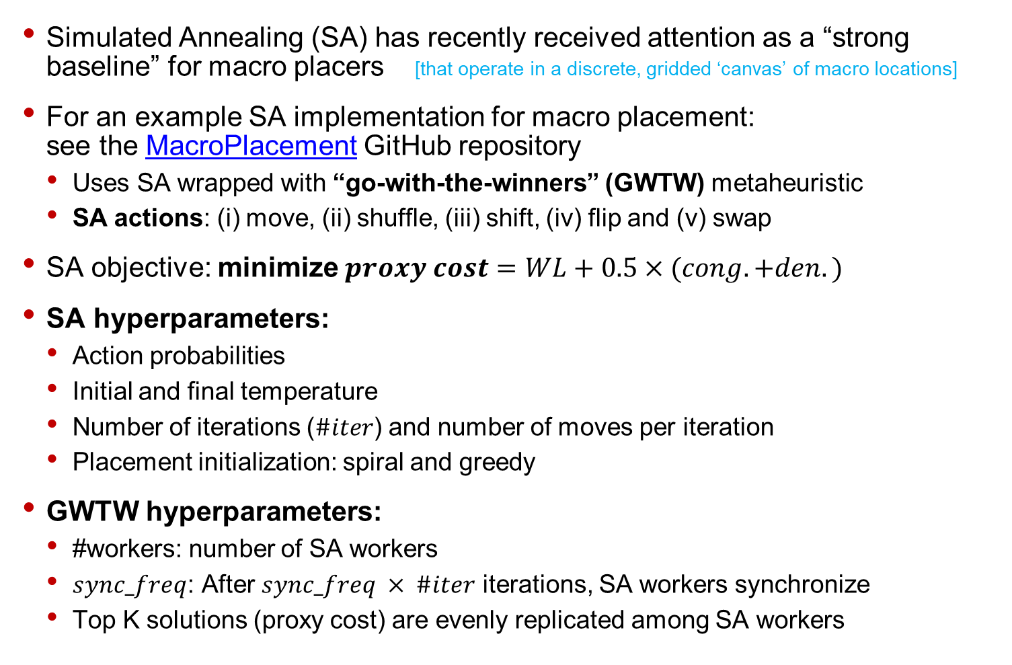
Simulated Annealing for Macro Placement
Simulated Annealing (SA) has recently received attention as a “strong baseline” for macro placers [that operate in a discrete, gridded ‘canvas’ of macro locations]
For an example SA implementation for macro placement: see the MacroPlacement GitHub repository
Uses SA wrapped with “go-with-the-winners” (GWTW) metaheuristic
SA actions: (i) move, (ii) shuffle, (iii) shift, (iv) flip and (v) swap
SA objective: minimize $proxy cost=WL+0.5×(cong. +den.)$
SA hyperparameters:
Action probabilities
Initial and final temperature
Number of iterations ($\#iter$) and number of moves per iteration
Placement initialization: spiral and greedy
GWTW hyperparameters:
#workers: number of SA workers
$sync_freq$: After $sync_freq × \#iter$ iterations, SA workers synchronize
Top K solutions (proxy cost) are evenly replicated among SA workers

Slide 37
Reproducibility of SA Results
SA is implemented using C++
Deterministic outcome:
Use of seed ensures deterministic SA result
Assign different seed for each SA worker ensure variation
Deterministic code yields different outcomes across C++ versions/environments
Reproducible only on same compute machine and same environment
Floating point operations: varying results across CPUs
Lookup table for computing exponents ensures determinism → Lookup table helps speed up SA code
Reproducibility across different platforms
Need to ensure same environment, same lookup table and same input
Containerization: Docker/Singularity images ensure same environment
Providing run script with lookup table ensures exact same SA input

Slide 38
Power Grid Generation
Thanks to Dr. Peter Gadfort (LinkedIn)
Director of Silicon Engineering, Zero ASIC
Kahng ECE 260C SP25

Slide 39
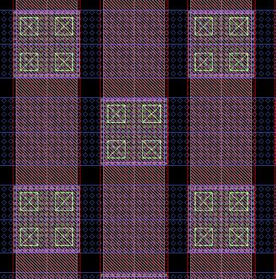
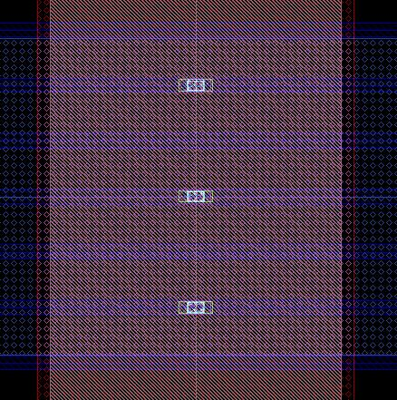
Power Grid Design and Analysis
Typically, power grids are constructed on higher metal layers due to their lower sheet resistance
and higher current density specification. Often top metal layers are thick.
Unless upper metal layers are used for signal routing, the usual approach is to maximize the
power grid, so long as the maximum metal density rules are satisfied.
We need to determine the following parameters.
Width and pitch of the power mesh stripes (depends on peak current)
How frequently to tap down from primary mesh to M1 rails
Via stack (e.g. – 1x4, 2x2, or 2x3), should be chosen carefully to avoid blocking
extra routing tracks and give low resistance
The two primary concerns are IR drop and electromigration.
Via Stack (2x3)
width
Power Rails
pitch
Power Stripes
Notes:
Power for design and analysis – we mainly focus on Power grid structure and design today and the analysis is for another day (or, optional Lab 7). Typically power grids are constructed with the highest metal layers in the chip, due to the fact that those layers have a lower sheet resistance and higher current carrying capability.
Often top metal layers are thick, as compared to the lower ones. Unless the upper metal layers are used for signal routing the usual approach is just to maximize the power grid. So as long as the maximum metal density rule is satisfied, we just add as much power as we can. Those are the layers, to make it * as close to a plane as we can get.
We do need to determine the following parameter, the width, pitch of the power mesh stripe. This pitch is important because as each stripe taps down to the wires below, you know what is going to be the frequency of tapping down to M1 rails? Its pretty standard, so, is it going to be 10 microns, 12? 7? All that is dependent on the pitch of the power mesh stripe of the higher level. So we need to determine this frequency of tap points.
Also we need to calculate the via stack, so, for e.g.., on the right we see 2 by 3 via stack. This is an upper level power stripe, tapping on to M1 power rail, with 6 vias on each layer on a tap, or 8 or 2.
All of this is determined by the current drawn by your design. So this should be chosen carefully and the aspect ratio, of all these vias should be chosen carefully, because whether I have a 1 by 4 stack or a 2 by stack of vias, you know I can use more of vertical routing, locations.
So it depends on how my top routes are congested, strictly in the vertical direction. I'd be better off going with the square vias here. It is ok to have the 1 by 4 vias, because am using less horizontal tracks in that case. Can also use 2 by 2, because they are the same in terms of the current carrying capacity, they are different in terms of routabilities.

Slide 40
Power Grid Design and Analysis
Structure of the multi-layer power mesh (You can see detail process using slide-show)
Space of VDD mesh and VSS mesh
Top metal layer’s minimum space rule
Draw the lowest mesh first
Stacked-via range must be changed to get better routability. It is recommended that the stacked-via size is the cross sectional area of the upper and the lower metal of the via.
4u M7 mesh
15.12u
4u M8 mesh
VDD rail
15.12u
VSS rail
M1 rail:
M4 mesh:
M5 mesh:
M6 mesh:
M1_2B mesh:
M2_2B mesh:
1u M5 mesh
2u M6 mesh
1u M4 mesh
Notes:
So if we look at the structure of a multilevel power mesh, which sometimes is still necessary, we can see the metal and rails. Here we see a vertical and 4 mesh stripes, when we tap down the metal on rails, then we can add some M5 again, 6, and then we say
Slide: 7 lower fat m1 and fat M2, call them M7 and M8 anyway.
That’s an example of a power mesh, where we have a mesh on all of the layers, and I think this is a little more efficient in distributing power, this can probably help reduce IR drop. On the other hand, it uses a lot of resources so is costly.
What process ??? (wild guess: around 28nm)
40

Slide 41
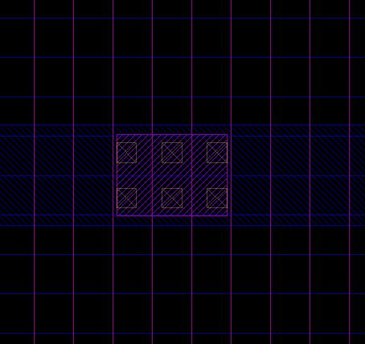
Power Grid Design and Analysis
Via Stacks
Typically we drop vias every time an upper layer power stripe crosses an M1 rail.
We choose the via stack so that the M1 rail is the limiting factor for IR drop – not the via stack.
The via stack can influence routability, depending on the number of tracks that it blocks.
Below example has 2x3 via array and blocks 4 vertical + 3 horizontal tracks.
A 2x2 array would block 3 vertical + 3 horizontal tracks.
A 1x4 array would block 5 vertical + 1 horizontal tracks.
VDD
VSS
Tracks
VSS
VDD
Notes:
So we talk about via stacks, this is just to give you a concept of where the via stacks are located. If we see the blue narrow stripes here, are going to be our Vdd, and Vss (and so on). The green here is going to attach from a higher metal layer to the stripe, so here we see the green Vdd attaching to very other stripe which is those are the Vdd ones, and the next are Vss, attached to the opposite ones.
It is just a given idea of what the overall power mesh structure looks like and you can really see how much area is reserved or contributed to power basically as opposed to signal routing. As we're tapping down from a higher layer all the way to Metal 1 which could be going from M8 or even M9 to Metal 1, you can see where this via stack becomes important because it is blocking running tracks and it is doing it rather frequently. So, choosing a via stack is important. Also it does need to now get the gating item with one of the width of our library M1 rails to meet the gating item in terms of where we start to see , you know, problems with the EM something like that ..You don't want the problem to be the via stack. So put enough vias.
So, this here shows an example of the via stack and this one is 2x3.

Slide 42
Macro Connection Cases: Side, Top, Rotated…
Side pin type
Top pin type
M6 mesh
M7 mesh
M5 mesh
M5 mesh
M5 pin connects to M6 mesh
M4 connector
M6 mesh
M5 mesh does not run across the macro
M6 mesh does not run across the macro
Rotated block: M5 pin connects to M7 mesh
M3 connector
Notes:
So, this shows a power grid design where we’re connecting to macros. There are several ways to do that. Some macros may have the side tap pins where you just have to connect to the power pins from the side of the macro and in other cases we can actually see the pins going horizontally across or vertically, in this case, across the macro. So, we need to be able to connect to these pins from the upper metal layers.
So, this is a rotated block down here (at bottom-right): we're showing that the M5 pins are connecting to the M7 mesh. So we need to actually ...we're breaking the M6 mesh in this case basically to do the connection because we have to go directly from M7 to M5. In this case, we can just continue our power mesh as usual... m7 to the vertical and 6 is going to attach to the horizontal tracks.
And this is what you would normally expect to see on a memory and connections like the other one may happen on non-memory things like switching regulators ... so both are used in every chip.
Note: the tiny transistors in an SRAM block may “print well” only in one direction – so, beginning with I would say the 90nm node it was kind of frowned on to rotate memories. But large analog circuits such as in a voltage regulator can have rotated orientation, and power must be delivered anyway.
42

Slide 43
pdn (aka pdngen) User Interface
set_voltage_domain - define a new power domain
define_pdn_grid - defines a new grid
add_pdn_stripe - add straps and followpins
add_pdn_ring - add rings
add_pdn_connect - add layer connectivity
pdngen - create grids

Slide 44
Main PDN Build Steps
1. Extract existing routing and blockages https://github.com/The-OpenROAD-Project/OpenROAD/blob/c34a30e0045eb68ad30c98f653e57f9b7f12d83c/src/pdn/src/PdnGen.cc#L112
2. For each grid: https://github.com/The-OpenROAD-Project/OpenROAD/blob/c34a30e0045eb68ad30c98f653e57f9b7f12d83c/src/pdn/src/PdnGen.cc#L136
a. Create rings, if requested https://github.com/The-OpenROAD-Project/OpenROAD/blob/c545b771cfd5a7a9c1f4c71e869899ac978ffb5f/src/pdn/src/rings.cpp#L223
b. Create straps https://github.com/The-OpenROAD-Project/OpenROAD/blob/c545b771cfd5a7a9c1f4c71e869899ac978ffb5f/src/pdn/src/straps.cpp#L170
c. Check connectivity and do channel repair (slide)
3. Estimate vias https://github.com/The-OpenROAD-Project/OpenROAD/blob/c34a30e0045eb68ad30c98f653e57f9b7f12d83c/src/pdn/src/PdnGen.cc#L148
4. Trim excess https://github.com/The-OpenROAD-Project/OpenROAD/blob/c34a30e0045eb68ad30c98f653e57f9b7f12d83c/src/pdn/src/PdnGen.cc#L151
5. Commit to database https://github.com/The-OpenROAD-Project/OpenROAD/blob/c34a30e0045eb68ad30c98f653e57f9b7f12d83c/src/pdn/src/PdnGen.cc#L731
a. Create all vias DRC free https://github.com/The-OpenROAD-Project/OpenROAD/blob/c34a30e0045eb68ad30c98f653e57f9b7f12d83c/src/pdn/src/via.cpp
b. Write wires to database

Slide 45
Rings
Straps
Macro

Slide 46
Rings
Straps
Macro disconnected

Slide 47
Rings
Straps
Straps trimmed for routing
Macro connected
Kahng ECE 260C SP25

Slide 48
Channel Repair
https://github.com/The-OpenROAD-Project/OpenROAD/blob/c34a30e0045eb68ad30c98f653e57f9b7f12d83c/src/pdn/src/straps.cpp#L1532
1. Find disconnected channels (floating power grid shapes)
2. For each channel:
a. Find appropriate connection layers
b. Attempt repair in the center of the channels, if success, stop
c. Bisect channel and attempt repair in on left and right side of channel, if success, stop, else keep trying
i. Stop when bisection no longer can make progress

Slide 49
pdngen Improvements / Problem Statements
Automatic connectivity rules (add_pdn_connect)
Create rules automatically for defining grid connectivity based on layers used, instances present, etc.
Edge connectivity
Enable the power grid to connect to edge ports for macros, right now this is only possible on pad cells and standard cells, for macros we only connect from the top which requires macros use lower metals for power and routing. This is not a huge problem in nodes with a large number of metal layers, but for sky130, ihp130, etc, this imposes a large penalty.
Power grid reinforcement (eco power grid)
Later in most flows, after detailed placement, it may be possible to determine if additional wires are needed to ensure IR drop stays within limits based on the power requirements of those areas. On the opposite side, it maybe possible to prune the grid if IR drop is not an issue and free up routing resources. [cf. https://arxiv.org/abs/2110.14184]
Automatic power grid definition (hard)
Given an IR drop goal, create a power grid that meets this requirement based on the parasitic resistances and estimated power (either from placement or good guesses)

Slide 50
Paper References
H. Murata, K. Fujiyoshi, S. Nakatake and Y. Kajitani, “VLSI module placement based on rectangle-packing by the sequence-pair”, IEEE Trans. on CAD, 15(12), 1996, pp. 1518-1524.
X. Tang and D. F. Wong, “FAST-SP: a fast algorithm for block placement based on sequence pair”, Proc. ASP-DAC, 2001, pp. 521-526.
S. N. Adya and I. L. Markov, “Fixed-outline Floorplanning : Enabling Hierarchical Design”, IEEE Trans. on VLSI Systems, 11(6), 2003, pp. 1120-1135.
S. Kirkpatrick, C. D. Gelatt, Jr. and M. P. Vecchi, “Optimization by Simulated Annealing”, Science 220(4598) 1983, pp. 671-680.

Slide 51
BACKUP
Kahng ECE 260C SP25

Slide 52
B*-Tree Floorplan Representation
Ordered binary tree (cf. “Packing Tree”, “O-Tree”)
Root represents the block on the left-bottom corner
Left child of node n_{i} represents the lowest unvisited block that belongs to the set of blocks located on the right-hand side of and adjacent to b_{i}
x_{j} = x_{i} + w_{i}
Right child of the node n_{i} represents the lowest block located above and with x-coordinate equal to that of b_{i}
x_{j} = x_{i}
n₀
b₆
b₇
n₁
n₂
b₂
b₅
n₃
b₃
n₅
n₆
b₀
b₄
b₁
n₄
n₇

